Slide 1
Love
Eavan Boland
www.aoifesnotes.com

Slide 2
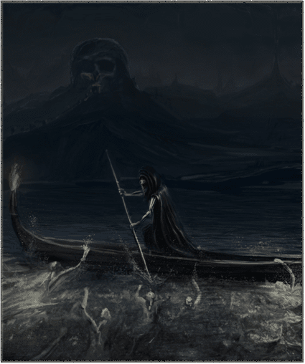
Myth
Opening is a blend of the ordinary and the extraordinary
The setting is merely a ‘mid-western town’ but it is a place where ‘myths collided’
Boland alludes to the myths rather than referring to them directly
www.aoifesnotes.com

Slide 3
It is dusk: a time of transition.
Boland switches between the past and the present
The dark river becomes the Styx
Introduces the idea of death
Boland’s young daughter became gravely ill when they lived in Iowa (she recovered!)
Journey to and from hospital - coming close to death
www.aoifesnotes.com

Slide 4
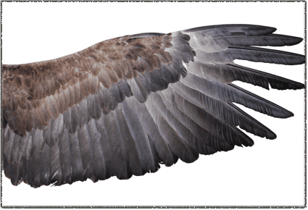
Myths collide…
Fact and myth collide in the ordinariness of the description of the furniture in their home
Accurate, down-to-earth language at this point
Meeting of the ordinary and the extraordinary - practicalities combine with powerful emotions
www.aoifesnotes.com

Slide 5
Through this difficult time, the couple discovered how strong love is
Power: ‘muscle’, ‘fire and air’
Interesting that the other elements - earth and water - are not mentioned. Love is invisible and intangible
Love becomes mythologised - a thing with ‘the feather and muscle of wings’
www.aoifesnotes.com

Slide 6
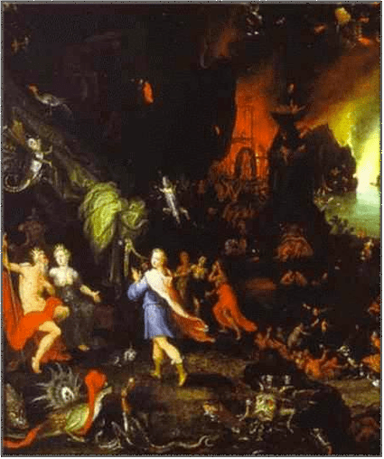
their voices failed…
Intense and emotional time in the couple's marriage
Aeneas or Odysseus' journey through hell. As they travelled, they met former companions who had died and were trapped in the underworld. The dead men tried to speak, but they could not be heard.
''a life they had shared and lost'' is clearly not just about the Greek hero and his friends.
The poet feels and her husband shared a different life, a different kind of love at that time.
www.aoifesnotes.com

Slide 7
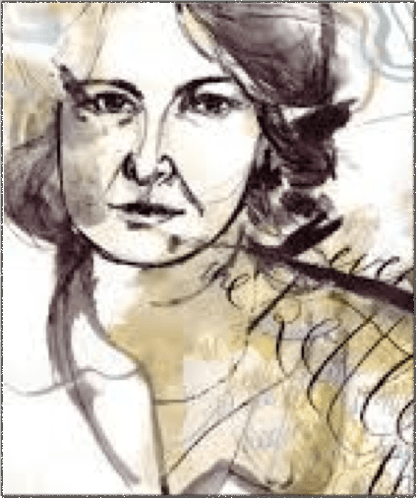
Why can’t she speak?
Intensity of emotion renders words impossible
It is in the past - can it be conjured up again?
Aeneas’ companions once shared adventures and hardships with him but now they cannot speak to one another of those times
www.aoifesnotes.com

Slide 8
Return to the present - ‘I am your wife’
Simple, declarative statements
The past and present meet and are summed up in six short sentences
Words in the first four sentences contain no Latin roots - they are plain - not the language of myth, as Boland ‘speaks plainly’
Stanzas become shorter as the poem draws to a close - sense of urgency reflects desire to come to a definite conclusion
www.aoifesnotes.com

Slide 9
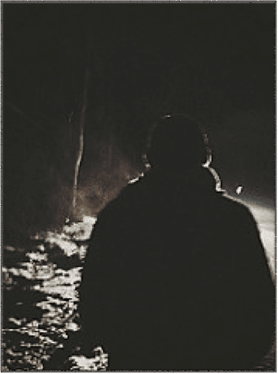
And yet…
The child is healed; the couple 'love each other still.'
On the surface, all is well. They converse and 'hear each other clearly.’
However…
The image of her husband at that time is the image of a hero
Cinematic description of him standing in the dark with snow on his shoulders - slightly unreal - dark, not clear light of day - romantic image
www.aoifesnotes.com

Slide 10
But that time has gone.
She wonders if love will ever come to live with them again.
Again, love is personified as something so formidable, so powerful, that even to be in his presence was awe-inspiring and uplifting.
The words ‘epic’ and ‘ascension’ bring the language back to mythology
www.aoifesnotes.com

Slide 11
No matter how passionate their love was then, it cannot be recaptured. Time passes and things change. Her words are ''shadows''. They are insubstantial.
She cannot communicate with the memory of a person as they once were.
He cannot be the man he was, and their lives must move on. underworld, she wants to cry out to her ''dear companion'' but he cannot hear her.
The image of her husband on the bridge turns and walks away.
Like the men trapped in Hades, she cannot follow.
The hero of the past is gone, and it is impossible to go back. No matter how passionate their love was then, it cannot be recaptured.
Time passes and things change. Her words are ''shadows''. They are insubstantial, and she cannot communicate with the memory of a person as they once were. He cannot be the man he was, and their lives must move on.
www.aoifesnotes.com

Slide 12
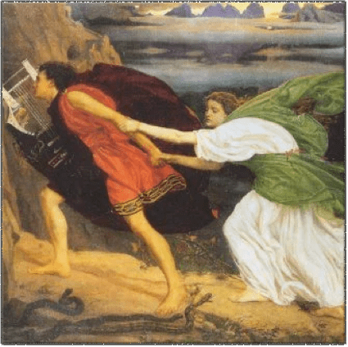
Theme
Love changes
Earlier intensity may go
However, even though love is different now, it is still strong
This is not a negative view of love
www.aoifesnotes.com

Slide 13
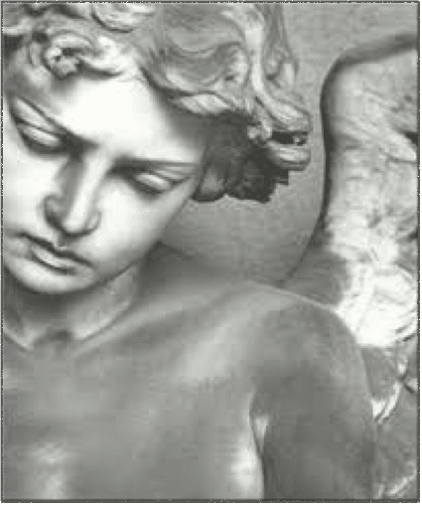
Tone
Sorrow, loss, longing
Nostalgia
Acceptance
Resignation
Recognition of love and affection that exists between husband and wife
www.aoifesnotes.com

